Slide 1
Chapter 7: Routing Dynamically
Routing & Switching

Slide 2
Chapter 7
7.1 Dynamic Routing Protocols
7.2 Distance Vector Dynamic Routing
7.3 RIP and RIPng Routing
7.4 Link-State Dynamic Routing
7.5 The Routing Table
7.6 Summary

Slide 3
Chapter 7: Objectives
Explain the basic operation of dynamic routing protocols.
Compare and contrast dynamic and static routing.
Determine which networks are available during an initial network discovery phase.
Define the different categories of routing protocols.
Describe the process by which distance vector routing protocols learn about other networks.
Identify the types of distance-vector routing protocols.
Configure the RIP routing protocol.
Configure the RIPng routing protocol.
Explain the process by which link-state routing protocols learn about other networks.

Slide 4
Chapter 7: Objectives (cont.)
Describe the information sent in a link-state update.
Describe advantages and disadvantages of using link-state routing protocols.
Identify protocols that use the link-state routing process. (OSPF, IS-IS)
Determine the route source, administrative distance, and metric for a given route.
Explain the concept of a parent/child relationship in a dynamically built routing table.
Compare the IPv4 classless route lookup process and the IPv6 lookup process.
Analyze a routing table to determine which route will be used to forward a packet.

Slide 5
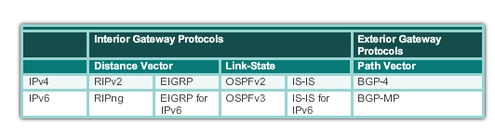
Dynamic Routing Protocol Operation The Evolution of Dynamic Routing Protocols
Dynamic routing protocols used in networks since the late 1980s
Newer versions support the communication based on IPv6
Routing Protocols Classification
Notes:
7.1.1.1 The Evolution of Dynamic Routing Protocols

Slide 6
Dynamic Routing Protocol Operation Purpose of Dynamic Routing Protocols
Routing Protocols are used to facilitate the exchange of routing information between routers.
The purpose of dynamic routing protocols includes:
Discovery of remote networks
Maintaining up-to-date routing information
Choosing the best path to destination networks
Ability to find a new best path if the current path is no longer available
Notes:
7.1.1.2 Purpose of Dynamic Routing Protocols

Slide 7
Dynamic Routing Protocol Operation Purpose of Dynamic Routing Protocols (cont.)
Main components of dynamic routing protocols include:
Data structures - Routing protocols typically use tables or databases for its operations. This information is kept in RAM.
Routing protocol messages - Routing protocols use various types of messages to discover neighboring routers, exchange routing information, and other tasks to learn and maintain accurate information about the network.
Algorithm - Routing protocols use algorithms for facilitating routing information for best path determination.
Notes:
7.1.1.2 Purpose of Dynamic Routing Protocols (cont.)

Slide 8
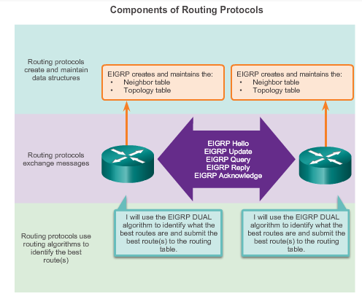
Dynamic Routing Protocol Operation Purpose of Dynamic Routing Protocols (cont.)
Notes:
7.1.1.2 Purpose of Dynamic Routing Protocols (cont.)

Slide 9
Dynamic Routing Protocol Operation The Role of Dynamic Routing Protocols
Advantages of dynamic routing include:
Automatically share information about remote networks
Determine the best path to each network and add this information to their routing tables
Compared to static routing, dynamic routing protocols require less administrative overhead
Help the network administrator manage the time-consuming process of configuring and maintaining static routes
Disadvantages of dynamic routing include:
Part of a router’s resources are dedicated for protocol operation, including CPU time and network link bandwidth
Times when static routing is more appropriate
Notes:
7.1.1.3 The Role of Dynamic Routing Protocols

Slide 10
Dynamic verses Static Routing Using Static Routing
Networks typically use a combination of both static and dynamic routing.
Static routing has several primary uses:
Providing ease of routing table maintenance in smaller networks that are not expected to grow significantly.
Routing to and from a stub network. A network with only one default route out and no knowledge of any remote networks.
Accessing a single default router. This is used to represent a path to any network that does not have a match in the routing table.
Notes:
7.1.2.1 Using Static Routing

Slide 11
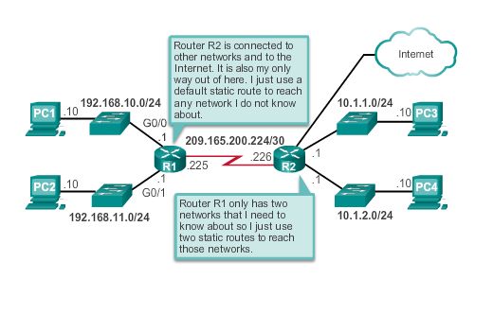
Dynamic verses Static Routing Using Static Routing (cont.)
Notes:
7.1.2.1 Using Static Routing (cont.)

Slide 12
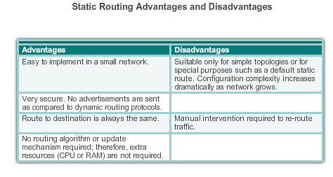
Dynamic verses Static Routing Static Routing Scorecard
Notes:
7.1.2.2 Static Routing Scorecard

Slide 13
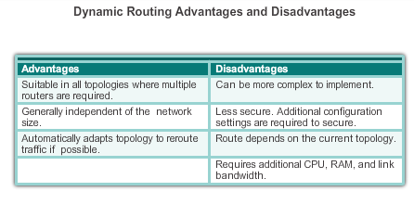
Dynamic verses Static Routing Dynamic Routing Scorecard
Notes:
7.1.2.4 Dynamic Routing Scorecard

Slide 14
Routing Protocol Operating Fundamentals Dynamic Routing Protocol Operation
In general, the operations of a dynamic routing protocol can be described as follows:
The router sends and receives routing messages on its interfaces.
The router shares routing messages and routing information with other routers that are using the same routing protocol.
Routers exchange routing information to learn about remote networks.
When a router detects a topology change the routing protocol can advertise this change to other routers.
Notes:
7.1.3.1 Dynamic Routing Protocol Operation

Slide 15
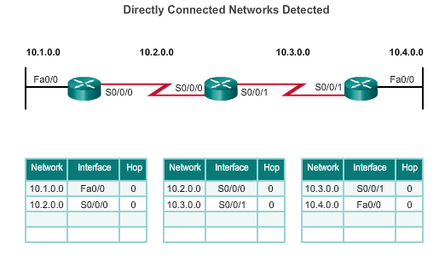
Routing Protocol Operating Fundamentals Cold Start
R1 adds the 10.1.0.0 network available through interface FastEthernet 0/0 and 10.2.0.0 is available through interface Serial 0/0/0.
R2 adds the 10.2.0.0 network available through interface Serial 0/0/0 and 10.3.0.0 is available through interface Serial 0/0/1.
R3 adds the 10.3.0.0 network available through interface Serial 0/0/1 and 10.4.0.0 is available through interface FastEthernet 0/0.
Routers running RIPv2
Notes:
7.1.3.2 Cold Start

Slide 16
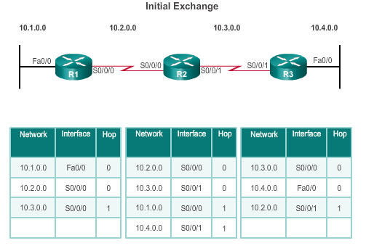
Routing Protocol Operating Fundamentals Network Discovery
R1:
Sends an update about network 10.1.0.0 out the Serial0/0/0 interface
Sends an update about network 10.2.0.0 out the FastEthernet0/0 interface
Receives update from R2 about network 10.3.0.0 with a metric of 1
Stores network 10.3.0.0 in the routing table with a metric of 1
Routers running RIPv2
Notes:
7.1.3.3 Network Discovery

Slide 17
Routing Protocol Operating Fundamentals Network Discovery (cont.)
R2:
Sends an update about network 10.3.0.0 out the Serial 0/0/0 interface
Sends an update about network 10.2.0.0 out the Serial 0/0/1 interface
Receives an update from R1 about network 10.1.0.0 with a metric of 1
Stores network 10.1.0.0 in the routing table with a metric of 1
Receives an update from R3 about network 10.4.0.0 with a metric of 1
Stores network 10.4.0.0 in the routing table with a metric of 1
Routers running RIPv2
Notes:
7.1.3.3 Network Discovery (cont.)

Slide 18
Routing Protocol Operating Fundamentals Network Discovery (cont.)
R3:
Sends an update about network 10.4.0.0 out the Serial 0/0/1 interface
Sends an update about network 10.3.0.0 out the FastEthernet0/0
Receives an update from R2 about network 10.2.0.0 with a metric of 1
Stores network 10.2.0.0 in the routing table with a metric of 1
Routers running RIPv2
Notes:
7.1.3.3 Network Discovery (cont.)

Slide 19
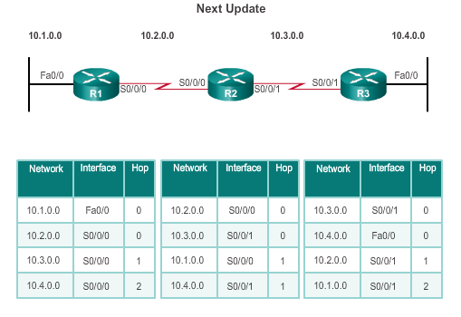
Routing Protocol Operating Fundamentals Exchanging the Routing Information
R1:
Sends an update about network 10. 1. 0. 0 out the Serial 0/0/0 interface
Sends an update about networks 10. 2. 0. 0 and 10. 3. 0. 0 out the FastEthernet0/0 interface
Receives an update from R2 about network 10. 4. 0. 0 with a metric of 2
Stores network 10. 4. 0. 0 in the routing table with a metric of 2
Same update from R2 contains information about network 10. 3. 0. 0 with a metric of 1. There is no change; therefore, the routing information remains the same
Routers running RIPv2
Notes:
7.1.3.4 Exchanging the Routing Information

Slide 20
Routing Protocol Operating Fundamentals Exchanging the Routing Information (cont.)
R2:
Sends an update about networks 10. 3. 0. 0 and 10. 4. 0. 0 out of Serial 0/0/0 interface
Sends an update about networks 10. 1. 0. 0 and 10. 2. 0. 0 out of Serial 0/0/1 interface
Receives an update from R1 about network 10. 1. 0. 0. There is no change; therefore, the routing information remains the same.
Receives an update from R3 about network 10. 4. 0. 0. There is no change; therefore, the routing information remains the same.
Routers running RIPv2
Notes:
7.1.3.4 Exchanging the Routing Information (cont.)

Slide 21
Routing Protocol Operating Fundamentals Exchanging the Routing Information (cont.)
R3:
Sends an update about network 10. 4. 0. 0 out the Serial 0/0/1 interface
Sends an update about networks 10. 2. 0. 0 and 10. 3. 0. 0 out the FastEthernet0/0 interface
Receives an update from R2 about network 10. 1. 0. 0 with a metric of 2
Stores network 10. 1. 0. 0 in the routing table with a metric of 2
Same update from R2 contains information about network 10. 2. 0. 0 with a metric of 1. There is no change; therefore, the routing information remains the same.
Routers running RIPv2
Notes:
7.1.3.4 Exchanging the Routing Information (cont.)

Slide 22
Routing Protocol Operating Fundamentals Achieving Convergence
The network is converged when all routers have complete and accurate information about the entire network:
Convergence time is the time it takes routers to share information, calculate best paths, and update their routing tables.
A network is not completely operable until the network has converged.
Convergence properties include the speed of propagation of routing information and the calculation of optimal paths. The speed of propagation refers to the amount of time it takes for routers within the network to forward routing information.
Generally, older protocols, such as RIP, are slow to converge, whereas modern protocols, such as EIGRP and OSPF, converge more quickly.
Notes:
7.1.3.5 Achieving Convergence

Slide 23
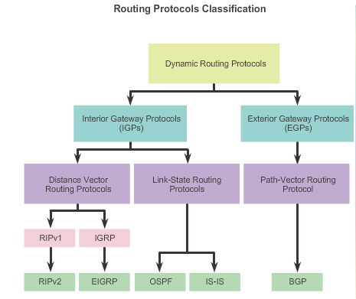
Types of Routing Protocols Classifying Routing Protocols
Notes:
7.1.4.1 Classifying Routing Protocols

Slide 24
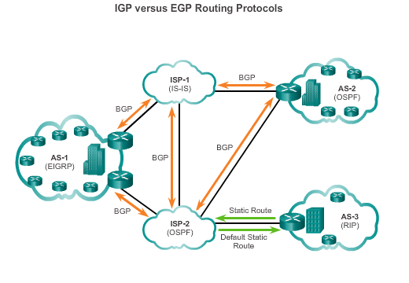
Types of Routing Protocols IGP and EGP Routing Protocols
Interior Gateway Protocols (IGP) -
Used for routing within an AS
Include RIP, EIGRP, OSPF, and IS-IS
Exterior Gateway Protocols (EGP) -
Used for routing between AS
Official routing protocol used by the Internet
Notes:
7.1.4.2 IGP and EGP Routing Protocols

Slide 25
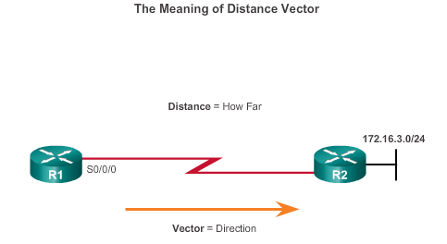
Types of Routing Protocols Distance Vector Routing Protocols
Distance vector IPv4 IGPs:
RIPv1 - First generation legacy protocol
RIPv2 - Simple distance vector routing protocol
IGRP - First generation Cisco proprietary protocol (obsolete)
EIGRP - Advanced version of distance vector routing
For R1, 172.16.3.0/24 is one hop away (distance). It can be reached through R2 (vector).
Notes:
7.1.4.3 Distance Vector Routing Protocols

Slide 26
Types of Routing Protocols Distance Vector or Link-State Routing Protocols
Distance vector protocols use routers as sign posts along the path to the final destination.
A link-state routing protocol is like having a complete map of the network topology. The sign posts along the way from source to destination are not necessary, because all link-state routers are using an identical map of the network. A link-state router uses the link-state information to create a topology map and to select the best path to all destination networks in the topology.
Notes:
7.1.4.3 Distance Vector Routing Protocols (cont.)

Slide 27
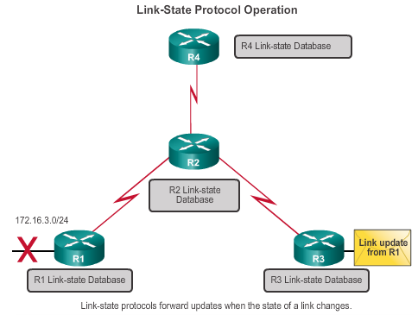
Types of Routing Protocols Link-State Routing Protocols
Link-state IPv4 IGPs:
OSPF - Popular standards based routing protocol
IS-IS - Popular in provider networks.
Notes:
7.1.4.4 Link-State Routing Protocols

Slide 28
Types of Routing Protocols Classful Routing Protocols
Classful routing protocols do not send subnet mask information in their routing updates:
Only RIPv1 and IGRP are classful.
Created when network addresses were allocated based on classes (class A, B, or C).
Cannot provide variable length subnet masks (VLSMs) and classless interdomain routing (CIDR).
Create problems in discontiguous networks.
Notes:
7.1.4.5 Classful Routing Protocols

Slide 29
Types of Routing Protocols Classless Routing Protocols
Classless routing protocols include subnet mask information in the routing updates:
RIPv2, EIGRP, OSPF, and IS_IS
Support VLSM and CIDR
IPv6 routing protocols
Notes:
7.1.4.6 Classless Routing Protocols

Slide 30
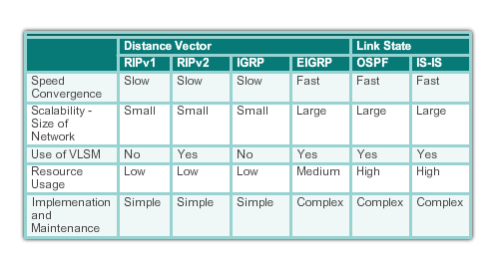
Types of Routing Protocols Routing Protocol Characteristics
Notes:
7.1.4.7 Routing Protocol Characteristics

Slide 31
Types of Routing Protocols Routing Protocol Metrics
A metric is a measurable value that is assigned by the routing protocol to different routes based on the usefulness of that route:
Used to determine the overall “cost” of a path from source to destination.
Routing protocols determine the best path based on the route with the lowest cost.
Notes:
7.1.4.8 Routing Protocol Metrics

Slide 32
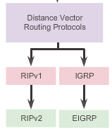
Distance Vector Routing Protocol Operation Distance Vector Technologies
Distance vector routing protocols:
Share updates between neighbors
Not aware of the network topology
Some send periodic updates to broadcast IP 255.255.255.255 even if topology has not changed
Updates consume bandwidth and network device CPU resources
RIPv2 and EIGRP use multicast addresses
EIGRP will only send an update when topology has changed
Notes:
7.2.1.1 Distance Vector Technologies

Slide 33
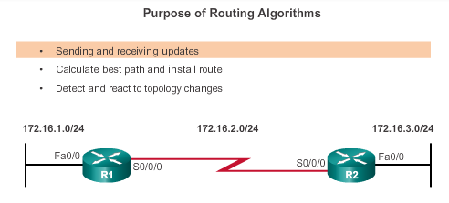
Distance Vector Routing Protocol Operation Distance Vector Algorithm
RIP uses the Bellman-Ford algorithm as its routing algorithm.
IGRP and EIGRP use the Diffusing Update Algorithm (DUAL) routing algorithm developed by Cisco.
Notes:
7.2.1.2 Distance Vector Algorithm

Slide 34
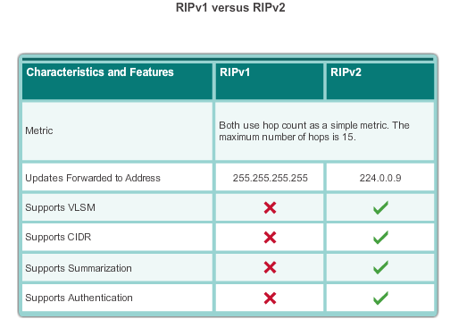
Types of Distance Vector Routing Protocols Routing Information Protocol
Routing updates broadcasted every 30 seconds
Updates use UDP port 520
RIPng is based on RIPv2 with a 15 hop limitation and the administrative distance of 120
Notes:
7.2.2.1 Routing Information Protocol

Slide 35
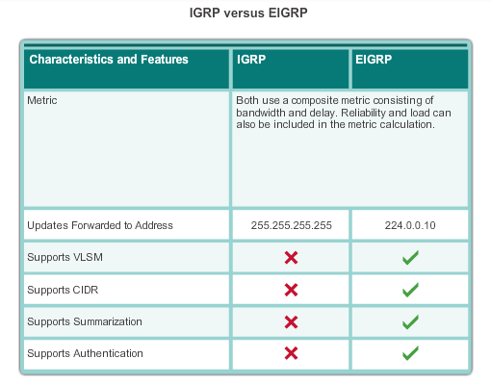
Types of Distance Vector Routing Protocols Enhanced Interior-Gateway Routing Protocol
EIGRP:
Is bounded triggered updates
Uses a Hello keepalives mechanism
Maintains a topology table
Supports rapid convergence
Is a multiple network layer protocol support
Notes:
7.2.2.2 Enhanced Interior-Gateway Routing Protocol

Slide 36
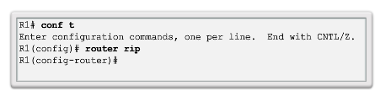
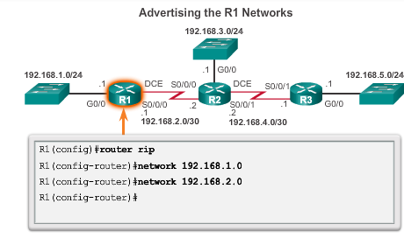
Configuring the RIP Protocol Router RIP Configuration Mode Advertising Networks
Notes:
7.3.1.1 Router RIP Configuration Mode
7.3.1.2 Advertising Networks

Slide 37
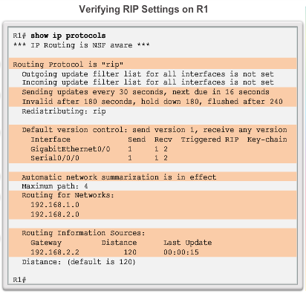
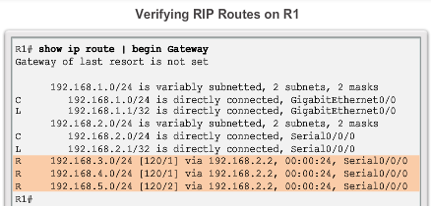
Configuring the RIP Protocol Examining Default RIP Settings
Notes:
7.3.1.3 Examining Default RIP Settings

Slide 38
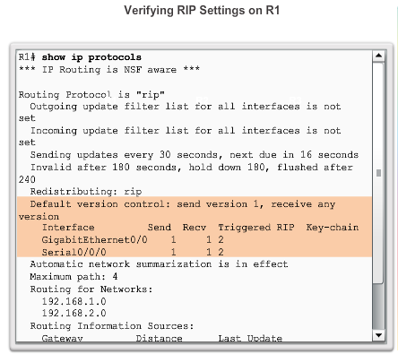
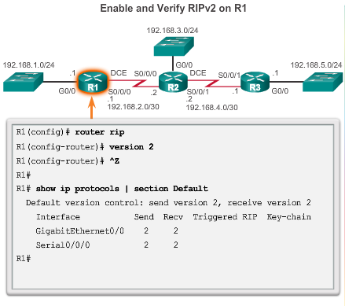
Configuring the RIP Protocol Enabling RIPv2
Notes:
7.3.1.4 Enabling RIPv2

Slide 39
Configuring the RIP Protocol Disabling Auto Summarization
Similarly to RIPv1, RIPv2 automatically summarizes networks at major network boundaries by default.
To modify the default RIPv2 behavior of automatic summarization, use the no auto-summary router configuration mode command.
This command has no effect when using RIPv1.
When automatic summarization has been disabled, RIPv2 no longer summarizes networks to their classful address at boundary routers. RIPv2 now includes all subnets and their appropriate masks in its routing updates.
The show ip protocols now states that automatic network summarization is not in effect.
Notes:
7.3.1.5 Disabling Auto Summarization

Slide 40
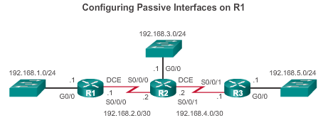
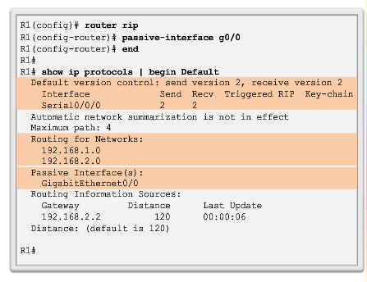
Configuring the RIP Protocol Configuring Passive Interfaces
Sending out unneeded updates on a LAN impacts the network in three ways:
Wasted Bandwidth
Wasted Resources
Security Risk
Notes:
7.3.1.6 Configuring Passive Interfaces

Slide 41
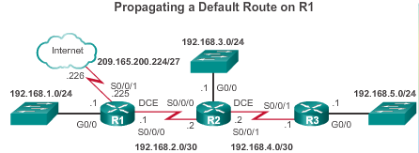
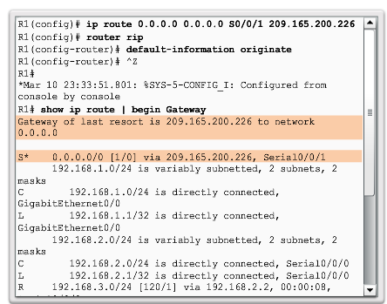
Configuring the RIP Protocol Propagating a Default Route
Notes:
7.3.1.7 Propagating a Default Route

Slide 42
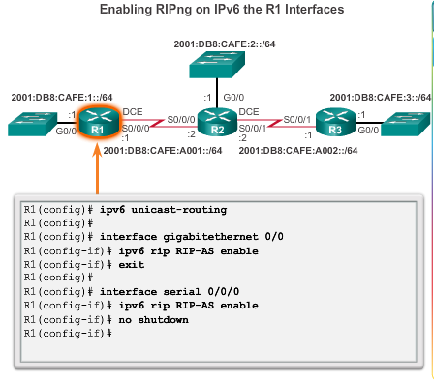
Configuring the RIPng Protocol Advertising IPv6 Networks
Notes:
7.3.2.1 Advertising IPv6 Networks

Slide 43
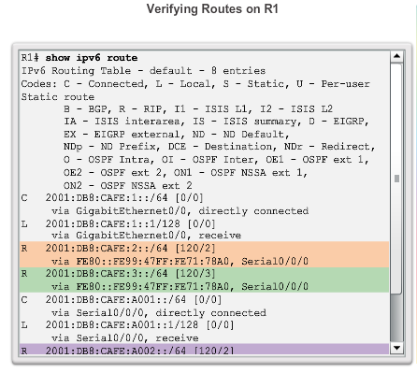
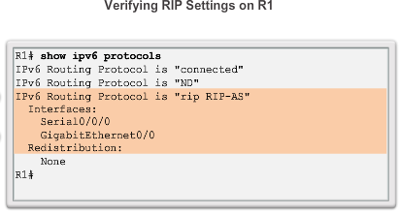
Configuring the RIPng Protocol Examining the RIPng Configuration
Notes:
7.3.2.2 Examining the RIPng Configuration

Slide 44
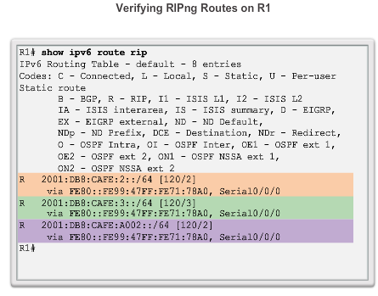
Configuring the RIPng Protocol Examining the RIPng Configuration (cont.)
Notes:
7.3.2.2 Examining the RIPng Configuration (cont.)

Slide 45
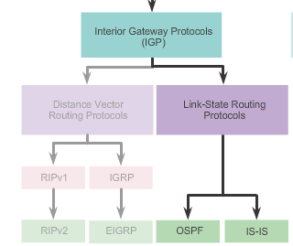
Link-State Routing Protocol Operation Shortest Path First Protocols
Notes:
7.4.1.1 Shortest Path First Protocols

Slide 46
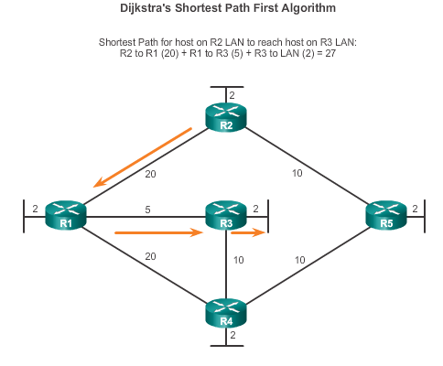
Link-State Routing Protocol Operation Dijkstra’s Algorithm
Notes:
7.4.1.2 Dijkstra's Algorithm

Slide 47
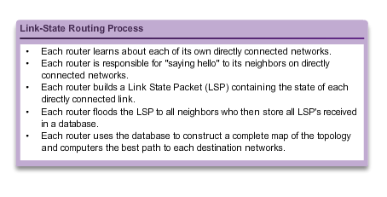
Link-State Updates Link-State Routing Process
Notes:
7.4.2.1 Link-State Routing Process

Slide 48
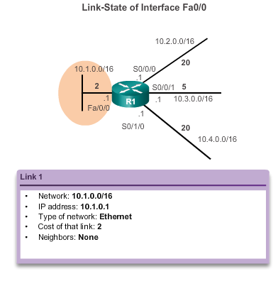
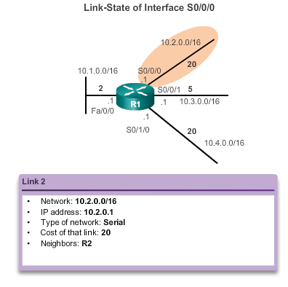
Link-State Updates Link and Link-State
The first step in the link-state routing process is that each router learns about its own links and its own directly connected networks.
Notes:
7.4.2.2 Link and Link-State

Slide 49
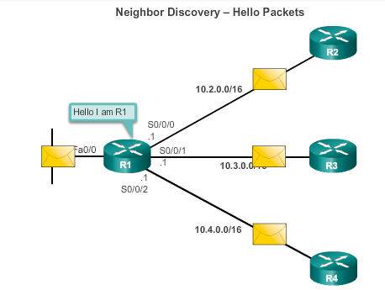
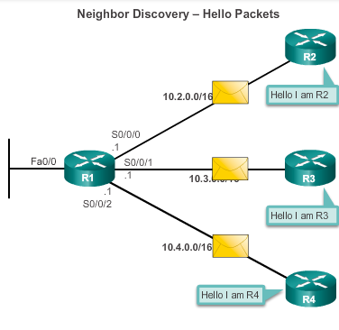
Link-State Updates Say Hello
The second step in the link-state routing process is that each router is responsible for meeting its neighbors on directly connected networks.
Notes:
7.4.2.3 Say Hello

Slide 50
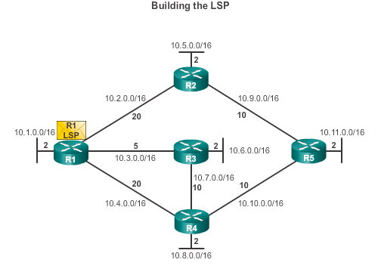
Link-State Updates Say Hello
The third step in the link-state routing process is that each router builds a link-state packet (LSP) containing the state of each directly connected link.
R1; Ethernet network 10.1.0.0/16; Cost 2
R1 -> R2; Serial point-to-point network; 10.2.0.0/16; Cost 20
R1 -> R3; Serial point-to-point network; 10.7.0.0/16; Cost 5
R1 -> R4; Serial point-to-point network; 10.4.0.0/16; Cost 20
Notes:
7.4.2.4 Building the Link-State Packet

Slide 51
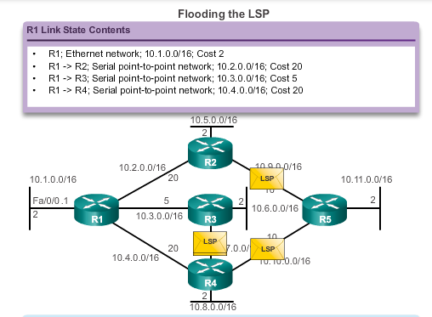
Link-State Updates Flooding the LSP
The fourth step in the link-state routing process is that each router floods the LSP to all neighbors, who then store all LSPs received in a database.
Notes:
7.4.2.5 Flooding the LSP

Slide 52
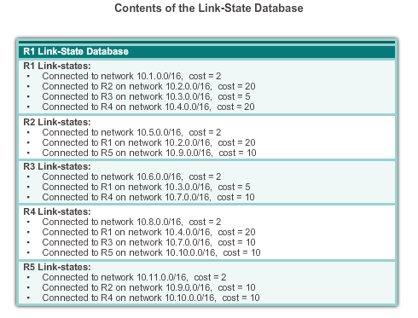
Link-State Updates Building the Link-State Database
The final step in the link-state routing process is that each router uses the database to construct a complete map of the topology and computes the best path to each destination network.
Notes:
7.4.2.6 Building the Link-State Database

Slide 53
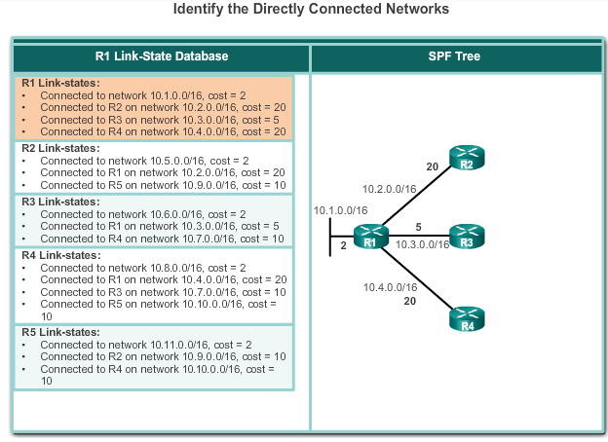
Link-State Updates Building the SPF Tree
Notes:
7.4.2.6 Building the Link-State Database (cont.)

Slide 54
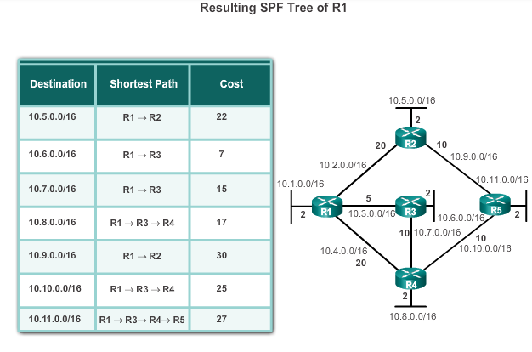
Link-State Updates Building the SPF Tree
Notes:
7.4.2.7 Building the SPF Tree

Slide 55
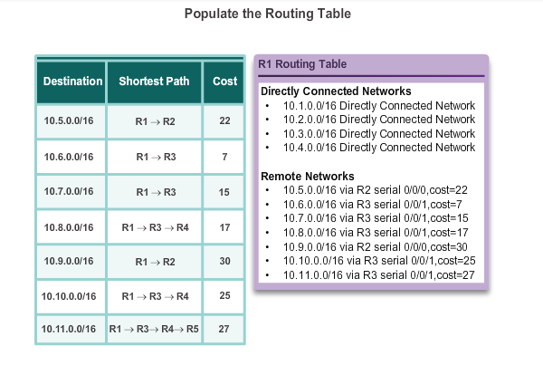
Link-State Updates Adding OSPF Routes to the Routing Table
Notes:
7.4.2.8 Adding OSPF Routes to the Routing Table

Slide 56
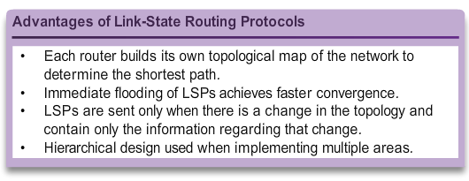
Why Use Link-State Routing Protocols Why Use Link-State Protocols?
Notes:
7.4.3.1 Why Use Link-State Protocols?

Slide 57
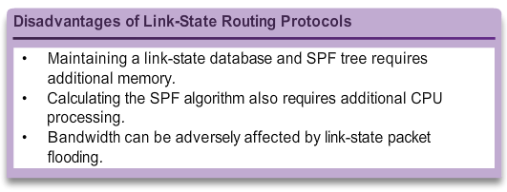
Why Use Link-State Routing Protocols Why Use Link-State Protocols?
Notes:
7.4.3.1 Why Use Link-State Protocols?

Slide 58
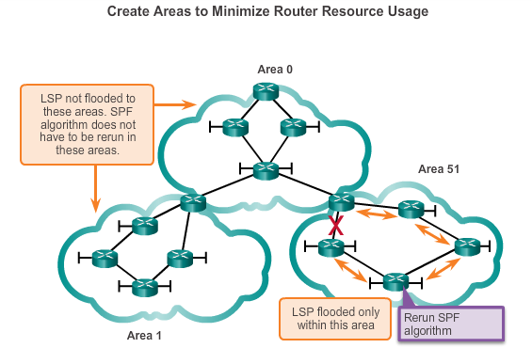
Why Use Link-State Routing Protocols Disadvantages of Link-State Protocols
Notes:
7.4.3.2 Support for Multiple Areas

Slide 59
Why Use Link-State Routing Protocols Protocols that Use Link-State
There are only two link-state routing protocols:
Open Shortest Path First (OSPF) most popular
began in 1987
two current versions
OSPFv2 - OSPF for IPv4 networks
OSPFv3 - OSPF for IPv6 networks
IS-IS was designed by International Organization for Standardization (ISO )
Notes:
7.4.3.3 Protocols that Use Link-State

Slide 60
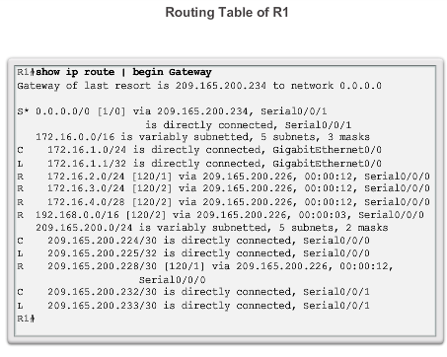
Parts of an IPv4 Route Entry Routing Table Entries
Notes:
7.5.1.1 Routing Table Entries

Slide 61
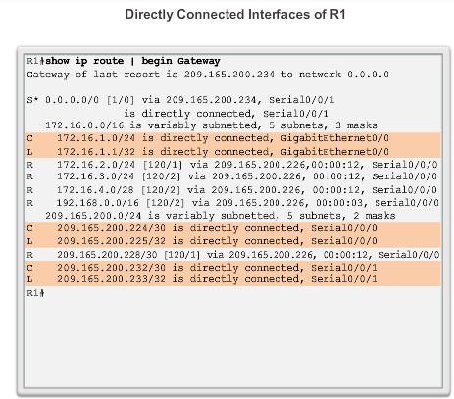
Parts of an IPv4 Route Entry Directly Connected Entries
Notes:
7.5.1.2 Directly Connected Entries

Slide 62
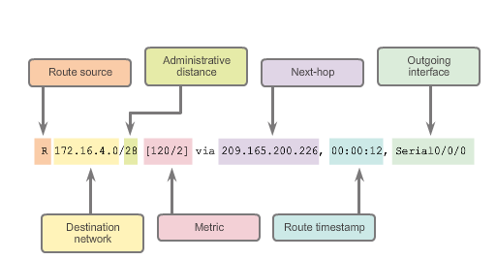
Parts of an IPv4 Route Entry Remote Network Entries
Notes:
7.5.1.3 Remote Network Entries

Slide 63

Dynamically Learned IPv4 Routes Routing Table Terms
Routes are discussed
in terms of:
Ultimate route
Level 1 route
Level 1 parent route
Level 2 child routes
Notes:
7.5.2.1 Routing Table Terms

Slide 64

Dynamically Learned IPv4 Routes Ultimate Route
An ultimate route is a routing table entry that contains either a next-hop IP address or an exit interface. Directly connected, dynamically learned, and link local routes are ultimate routes.
Notes:
7.5.2.2 Ultimate Route

Slide 65

Dynamically Learned IPv4 Routes Level 1 Route
Notes:
7.5.2.3 Level 1 Route

Slide 66

Dynamically Learned IPv4 Routes Level 1 Parent Route
Notes:
7.5.2.4 Level 1 Parent Route

Slide 67

Dynamically Learned IPv4 Routes Level 2 Child Route
Notes:
7.5.2.5 Level 2 Child Route

Slide 68
The Routing Table Route Lookup Process
If the best match is a level 1 ultimate route, then this route is used to forward the packet.
If the best match is a level 1 parent route, proceed to the next step.
The router examines child routes (the subnet routes) of the parent route for a best match.
If there is a match with a level 2 child route, that subnet is used to forward the packet.
If there is not a match with any of the level 2 child routes, proceed to the next step.
Notes:
7.5.3.1 Route Lookup Process

Slide 69
The Routing Table Route Lookup Process (cont.)
The router continues searching level 1 supernet routes in the routing table for a match, including the default route, if there is one.
If there is now a lesser match with a level 1 supernet or default routes, the router uses that route to forward the packet.
If there is not a match with any route in the routing table, the router drops the packet.
Notes:
7.5.3.1 Route Lookup Process (cont.)

Slide 70

The IPv4 Route Lookup Process Best Route = Longest Match
Notes:
7.5.3.2 Best Route = Longest Match

Slide 71
The IPv4 Route Lookup Process IPv6 Routing Table Entries
Components of the IPv6 routing table are very similar to the IPv4 routing table (directly connected interfaces, static routes, and dynamically learned routes).
IPv6 is classless by design, all routes are effectively level 1 ultimate routes. There is no level 1 parent of level 2 child routes.
Notes:
7.5.4.1 IPv6 Routing Table Entries

Slide 72


Analyze an IPVv6 Routing Table Directly Connected Entries
Notes:
7.5.4.2 Directly Connected Entries

Slide 73


Analyze an IPVv6 Routing Table Remote IPv6 Network Entries
Notes:
7.5.4.3 Remote IPv6 Network Entries

Slide 74
Chapter 7: Summary
Dynamic routing protocols:
Used by routers to automatically learn about remote networks from other routers
Purpose includes: discovery of remote networks, maintaining up-to-date routing information, choosing the best path to destination networks, and ability to find a new best path if the current path is no longer available
Best choice for large networks but static routing is better for stub networks.
Function to inform other routers about changes
Can be classified as either classful or classless, distance-vector or link-state, and an interior or an exterior gateway protocol
Notes:
Chapter 7 Summary

Slide 75
Chapter 7: Summary (cont.)
Dynamic routing protocols:
A link-state routing protocol can create a complete view or topology of the network by gathering information from all of the other routers
Metrics are used to determine the best path or shortest path to reach a destination network
Different routing protocols may use different (hops, bandwidth, delay, reliability, and load)
Show ip protocols command displays the IPv4 routing protocol settings currently configured on the router, for IPv6, use show ipv6 protocols
Notes:
Chapter 7 Summary

Slide 76
Chapter 7: Summary (cont.)
Dynamic routing protocols:
Cisco routers use the administrative distance value to determine which routing source to use
Each dynamic routing protocol has a unique administrative value, along with static routes and directly connected networks, lower is preferred the route
Directly connected networks are preferred source, followed by static routes and then various dynamic routing protocols
An OSPF link is an interface on a router, information about the state of the links is known as link-states
Link-state routing protocols apply Dijkstra’s algorithm to calculate the best path route which uses accumulated costs along each path, from source to destination, to determine the total cost of a route
Notes:
Chapter 7 Summary

Slide 77


